Slide 1



Business Data Management Project
Viva Finale
OPTIMIZING CASH FLOW AND STAGGERED CREDIT SALES SYSTEM FOR A B2B TEXTILE COMPANY
R.G. Nagappa Mudaliar And Sons
Shriram G - 21F2000668
September Term
Cycle III

Slide 2


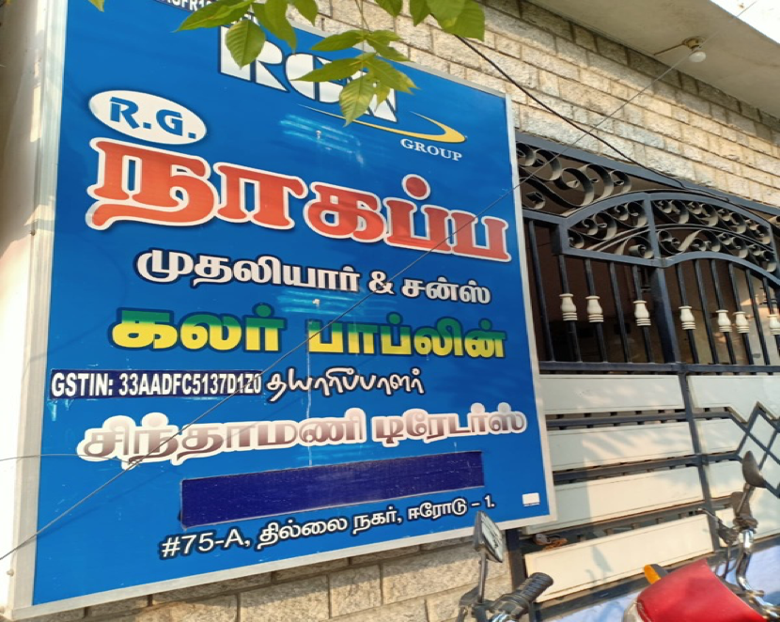
Organization And Problem Statement
Decades-old businesses facing multiple systemic issues
Has turnover in crores
Various factors influence performance months in advance
Complex interrelationships exist between factors
Need a unified framework to maintain the business with predictive analytics
Need a unified framework for setting up a Decision-Making Process
Primary Objectives:
Optimizing Cash Flow
Staggered Sale In Credit For Bad Debt Management

Slide 3

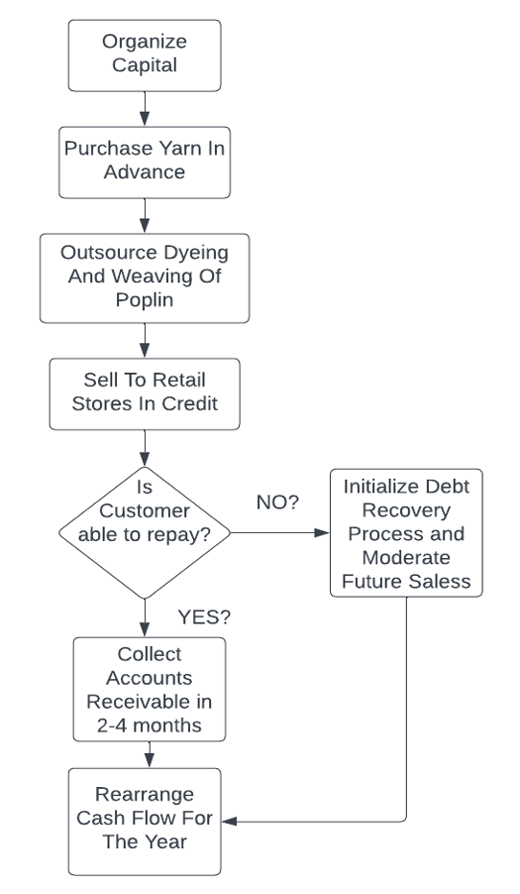

Business Model & Balance Sheet
1-Apr-21 to 31-Mar-22 | 1-Apr-21 to 31-Mar-22 | 1-Apr-21 to 31-Mar-22
 | R.G. NAGAPPA MUDALIAR & SONS | R.G. NAGAPPA MUDALIAR & SONS |  | R.G. NAGAPPA MUDALIAR & SONS | R.G. NAGAPPA MUDALIAR & SONS
Liabilities | as at 31-Mar-22 | as at 31-Mar-22 | Assets | as at 31-Mar-22 | as at 31-Mar-22
Capital Account |  | 10434222.37 | Fixed Assets |  | 1067337.35
D.ARVINTH CAPITAL A/C | 211962.50 |  | ACTIVA A/C | 52268.00
GOD'S A/C | 37.24 |  | AIR CONDITIONER | 1512.20
R.G.N.VELAYUTHAM CAPITAL A/C |  |  | BATTERY - LIVGUARD TALL TUBULAR | 12250.00
R.V. DEVASENAN CAPITAL A/C | 5857922.93 |  | C.C.T.V. CAMERA | 87.19
R.V.DEVASENAN CURRENT A/C |  |  | CELL PHONE | 3600.00
S. KALAISELVI CAPITAL A/C | 4364299.70 |  | COMPUTER | 2943.55
Loans (Liability) |  | 5359508.18 | FURNITURE & FITTINGS | 5835.72
Bank OD A/c | 2126365.85 |  | GENERATOR | 728.28
Secured Loans | 869477.00 |  | HYUNDAI VERNA
Unsecured Loans |  |  | INVERTOR - BATTERY A/C | 7776.72
DEVELOPMENT CREDIT BANK |  |  | PRINTER | 2743.20
R.G.N.VELAYUTHAM CURRENT A/C | 1188665.33 |  | SCOOTER | 926.80
R.G.N.VELAYUTHAM HUF A/C | 1175000.00 |  | SWATCH CUTTER | 27140.00
Current Liabilities |  | 1997494.51 | TOYOTO INNOVA CAR A/C | 949525.69
Duties & Taxes | -145780.55 |  | Current Assets |  | 16723887.71
Sundry Creditors | 2143275.06 |  | Closing Stock | 12468385.00
Suspense A/c |  |  | Deposits (Asset) | 5800.00
Profit & Loss A/c |  |  | Loans & Advances (Asset)
Opening Balance |  |  | Sundry Debtors | 4159254.00
Current Period | 88200.00 |  | Cash-in-hand | 86259.31
Less: Transferred | 88200.00 |  | Bank Accounts | 4189.40
Total |  | 17791225.06 | Total |  | 17791225.06
Factors affecting The Business are
Yarn Purchase Price
Procurement Time / Delay In Processing
Rise Of Bad Debt
Disturbances arise In Cash Flow

Slide 4
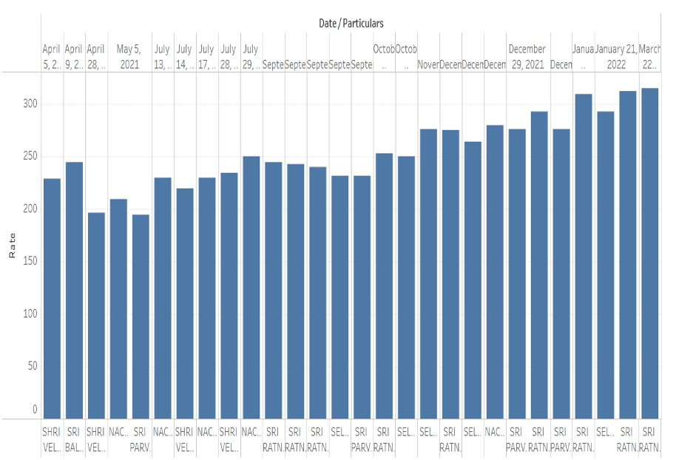
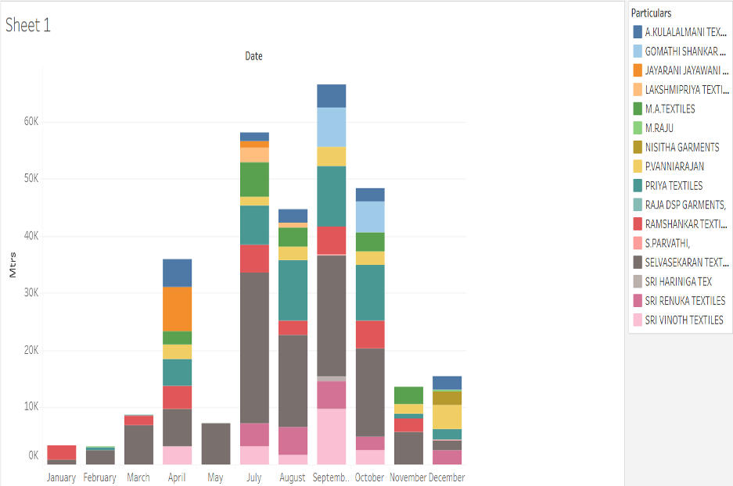
Requirement Of Business Owner
A Model Comprising Entire Business System.
Establish A Justified System For Sale In Credit To Regular Retailers And Defaulters.
At A Glance : Yarn Purchase Trend And Sales Trend Across a Year

Slide 5

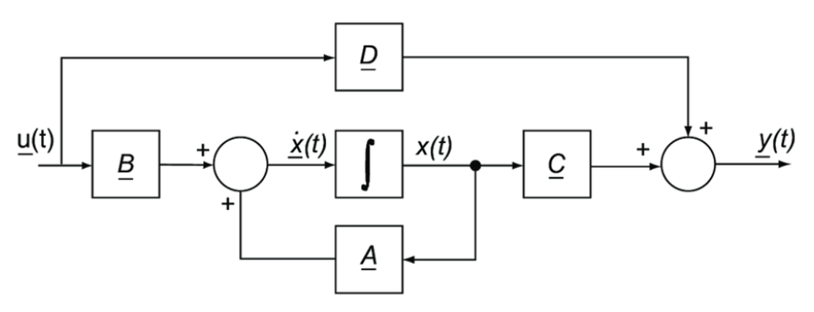
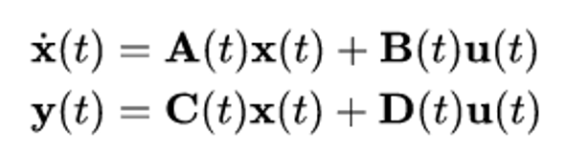
A COMPLEX SYSTEM MODELLING APPROACH
State-Space Analysis
Concepts of State Space Analysis For Financial System Engineering have been used.
Block Diagram
Equation
State Variables Vector :
Yarn Price
Expected Sales
Losses Accumulated At Time ‘T’

Slide 6
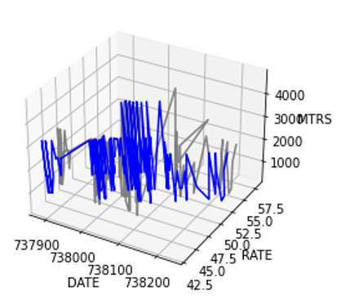
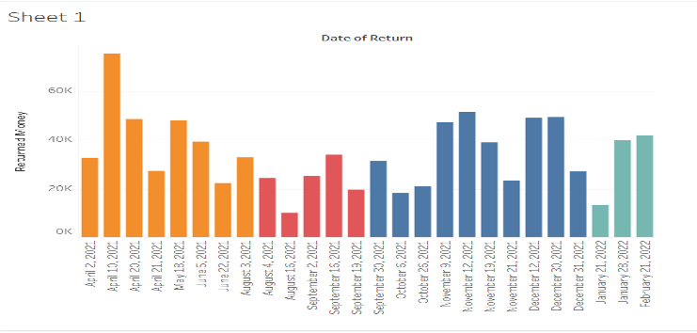
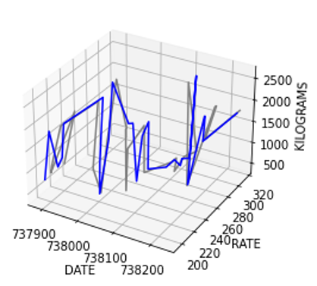
Some handy tips
Data available to us is discrete
Smoothing Is Done Before Training The State Space System
Regression Analysis Used For Smoothed Curve Representation
Debtors Return Patterns
Yarn Purchase
Sales Data

Slide 7
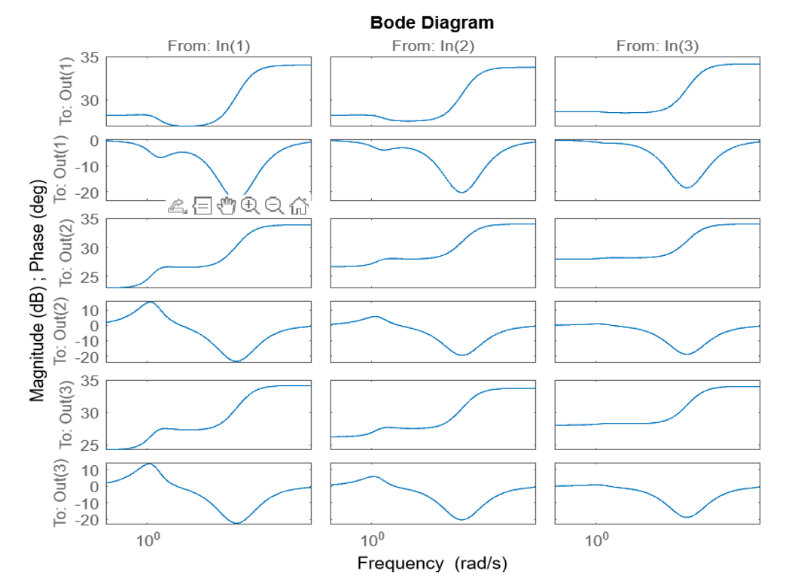

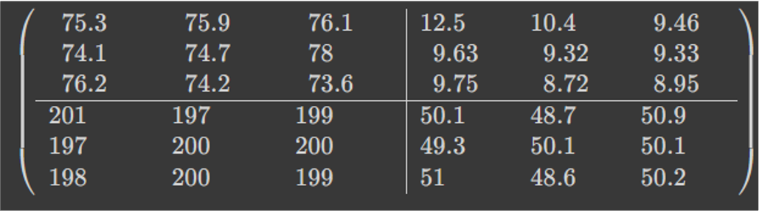
A COMPLEX SYSTEM MODELLING APPROACH
State-Space
Analysis Results
Bode Diagram And Derived State Space Matrices

Slide 8
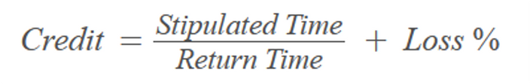
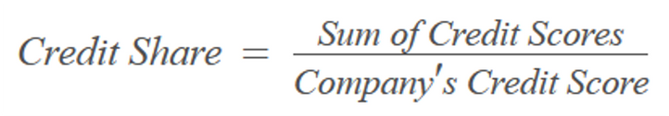
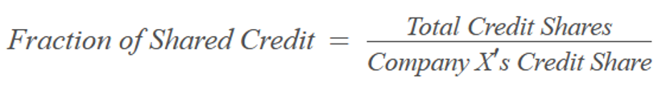
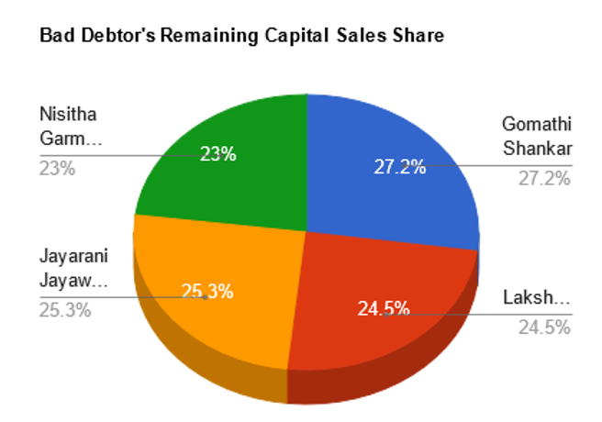
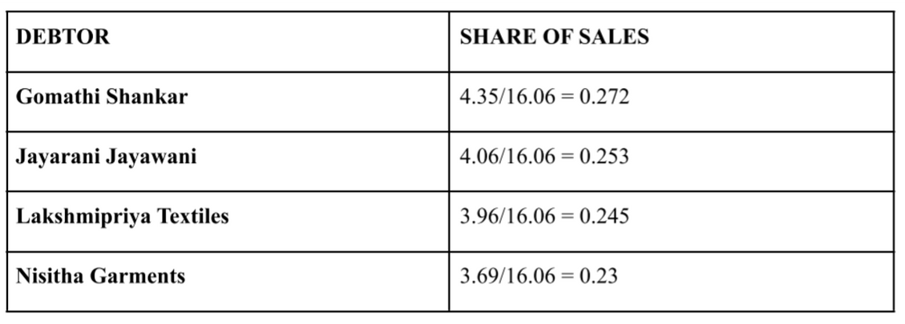
Debtor’s Credit Scoring System

Slide 9
Exploring...
PITFALLS
RECOMMENDATIONS
FUTURE SCOPE

Slide 10
Thank You

